Slide 1
Weekly meeting 4
Shengya Guo, CR/AVS3, 17.07.2024

Slide 2
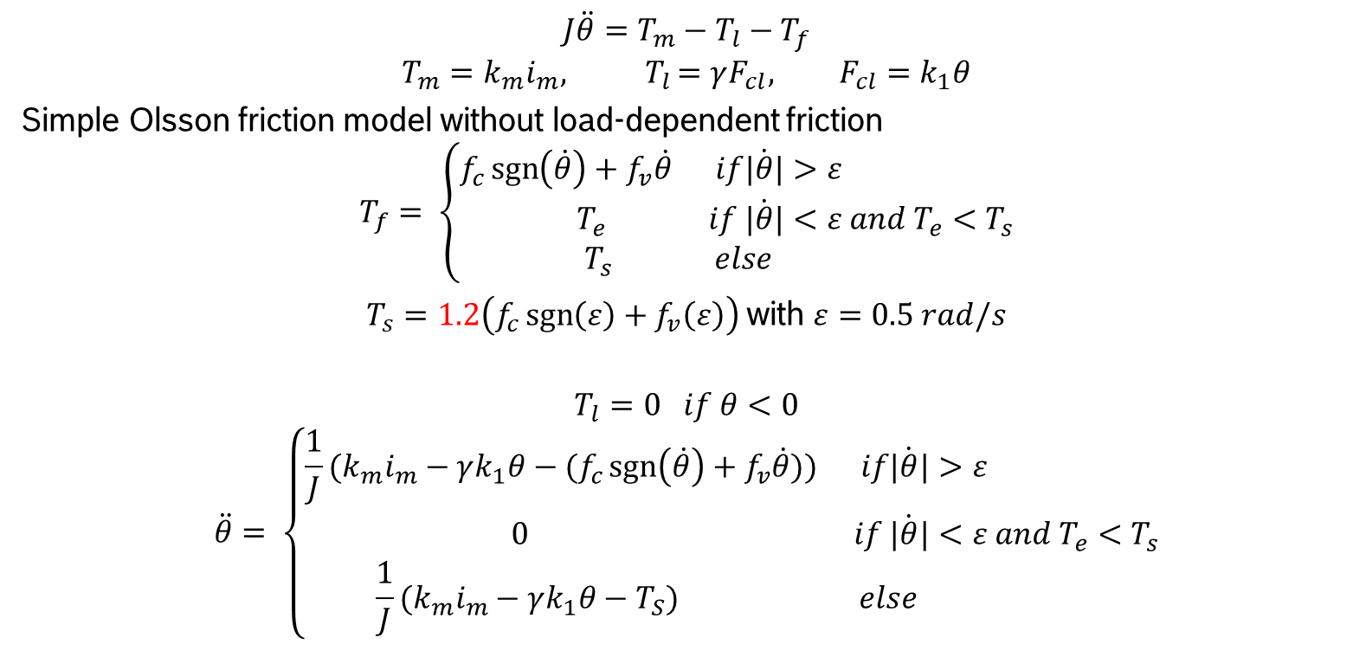
Simplified EMB model
$$J\ddot{θ}=T_{m}−T_{l}−T_{f}$$
$$T_{m}=k_{m}i_{m}{, T}_{l}=γF_{cl}, F_{cl}=k_{1}θ$$
Simple Olsson friction model without load-dependent friction
$$T_{f}= \left\{\begin{aligned}f_{c}\operatorname{sgn}\left(\dot{θ}\right)+f_{v}\dot{θ} if\dot{|θ|}&>ε \\ T_{e} if \dot{|θ|}&<ε and T_{e}<T_{s} \\ T_{s} else\end{aligned}\right.$$
$T_{s}=1.2\left(f_{c}\operatorname{sgn}\left(ε\right)+f_{v}\left(ε\right)\right)$with $ε=0.5 rad/s$
$$T_{l}=0 if θ<0$$
$$\ddot{θ}= \left\{\begin{aligned}{\frac{1}{J}(k_{m}i_{m}−γk_{1}θ−(f}_{c}\operatorname{sgn}\left(\dot{θ}\right)+f_{v}\dot{θ})) if\dot{|θ|}&>ε \\ 0 if \dot{|θ|}&<ε and T_{e}<T_{s} \\ {\frac{1}{J}(k_{m}i_{m}−γk_{1}θ−T}_{S}) else\end{aligned}\right.$$

Slide 3
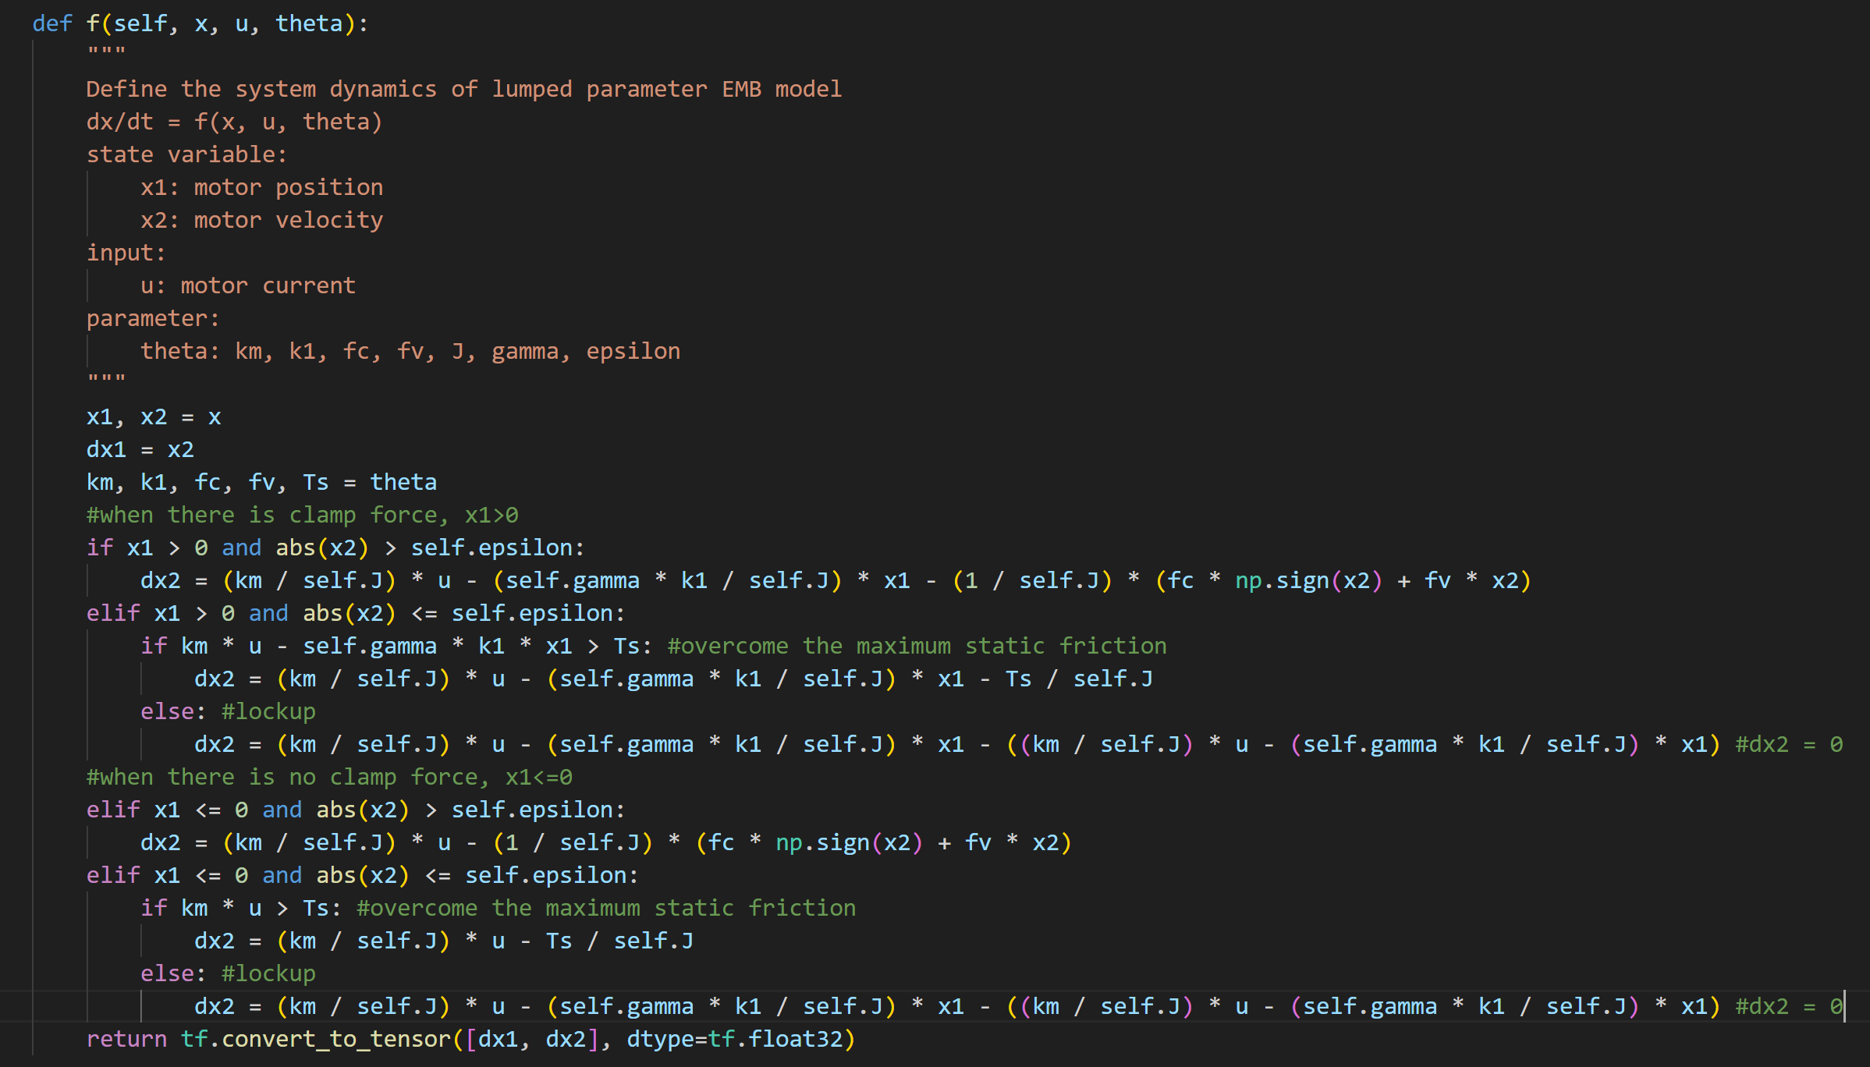
Simplified EMB model

Slide 4
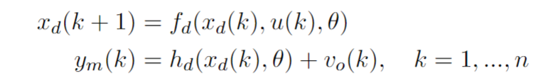
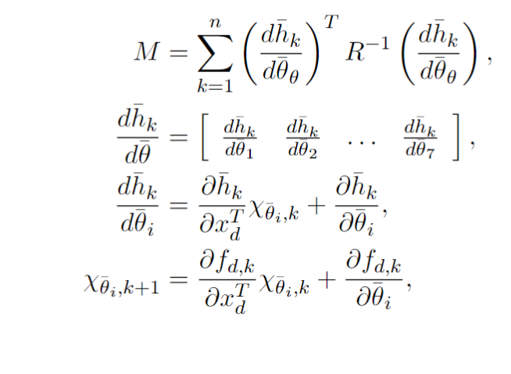
Calculation of the FI matrix
Sensitivity calculation need Jacobian matrix

Slide 5
Next
Reward could be calculated by at least every 5 step, because dim(M) = 5, for step < 5 can’t tell enough information.
Use pytorch\Tensorflow to calculate the Jacobian automatically.
Test Jacobian by giving random x0 and random v, Finite diff check in finite-difference approximation.py
Storage each 5 sensitivities and figure out the relationship
Read the new paper about the Trajectory Synthesis for Fisher Information Maximization

Slide 6
Automatically Jacobian matrix calculation by Tensorflow
Significantly running time increase when using Tensorflow auto gradient tools (145s for 350step), while manual gradient function only take 20s.

Slide 7
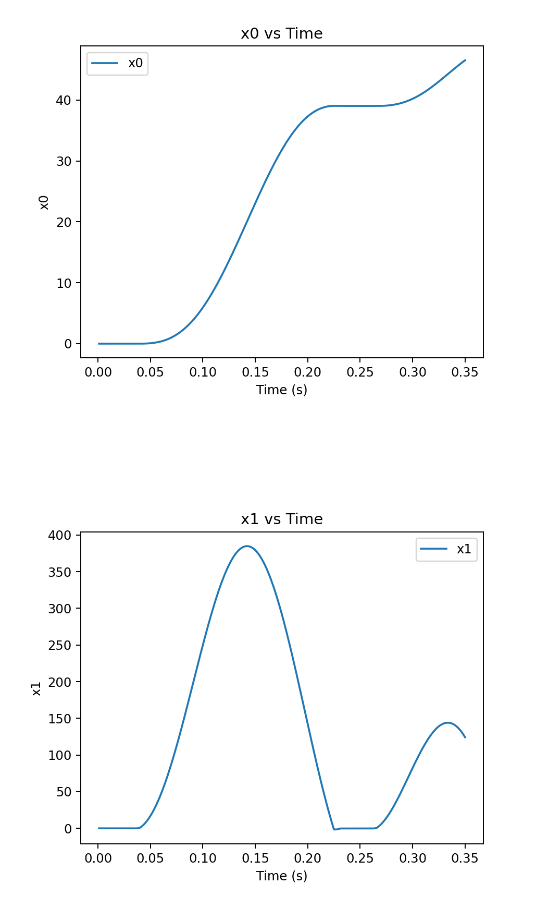
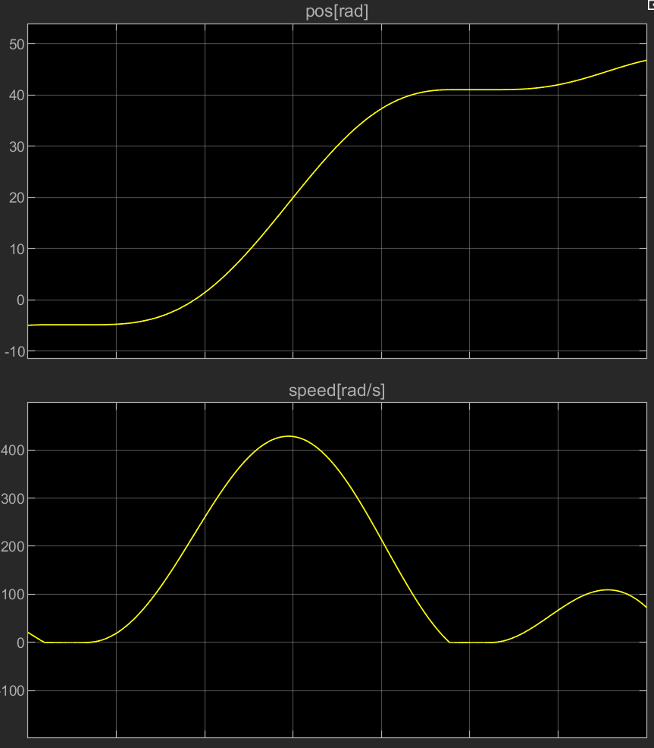
Calculation of the FI matrix

Slide 8
Next
Use continues function instead of if-else function
A friction selector function could help TF have a better performance
Innitializte FI matrix as a I matrix times 1e-6
Use det(M_new) – det(M_old) as step reward
See if M + M_T = 2
unconnected_gradients=UnconnectedGradients.ZERO which by default is None, solve the ’None’ Jacobian matrix in lockup
Small difference in sensitivity_y because of tf.matmul() and np.dot(), and then difference in FI matrix and then difference in det.
Noticed inconsistent result between float32 and float64, to make sure the maximal precise, use float64 instead
By add @tf.function by both f() and jacobian(), reduce the running time fome 120s to 2s. Its works with both if-else function and minmax function.

Slide 9
Next
def tf__f(self, x, u, theta):
with ag__.FunctionScope('f', 'fscope', ag__.ConversionOptions(recursive=True, user_requested=True, optional_features=(), internal_convert_user_code=True)) as fscope:
do_return = False
retval_ = ag__.UndefinedReturnValue()
(x1, x2) = ag__.converted_call(ag__.ld(tf).unstack, (ag__.ld(x),), None, fscope)
(km, k1, fc, fv) = ag__.converted_call(ag__.ld(tf).unstack, (ag__.ld(theta),), None, fscope)
dx1 = ag__.ld(x2)
Tm = ag__.ld(km) * ag__.ld(u)
Tl = ag__.ld(self).gamma * ag__.ld(k1) * ag__.converted_call(ag__.ld(tf).maximum, (ag__.ld(x1), 0.0), None, fscope)
Tf = (ag__.ld(fc) * ag__.converted_call(ag__.ld(tf).sign, (ag__.ld(x2),), None, fscope) + ag__.ld(fv) * ag__.ld(x2)) / ag__.ld(self).epsilon * ag__.converted_call(ag__.ld(tf).minimum, (ag__.converted_call(ag__.ld(tf).abs, (ag__.ld(x2),), None, fscope), ag__.ld(self).epsilon), None, fscope)
dx2 = (ag__.ld(Tm) - ag__.ld(Tl) - ag__.ld(Tf)) / ag__.ld(self).J
try:
do_return = True
retval_ = ag__.converted_call(ag__.ld(tf).convert_to_tensor, ([ag__.ld(dx1), ag__.ld(dx2)],), dict(dtype=ag__.ld(tf).float64), fscope)
do_return = False
raise
return fscope.ret(retval_, do_return)

Slide 10
Next

